Slide 1
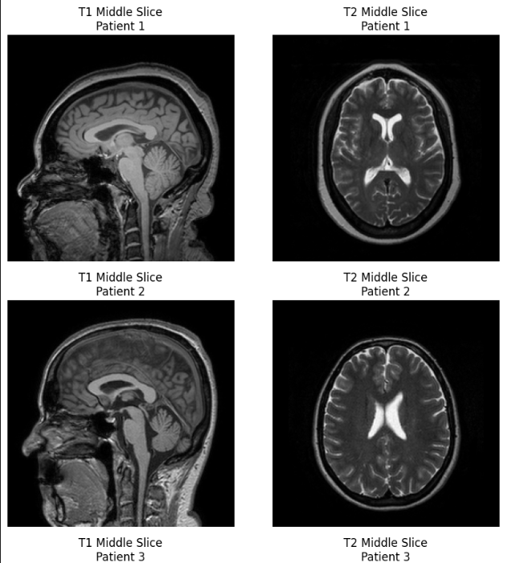
Bidirectional MRI Synthesis Using Diffusion
Prarthana Krishnamurthy
Northeastern University

Slide 2
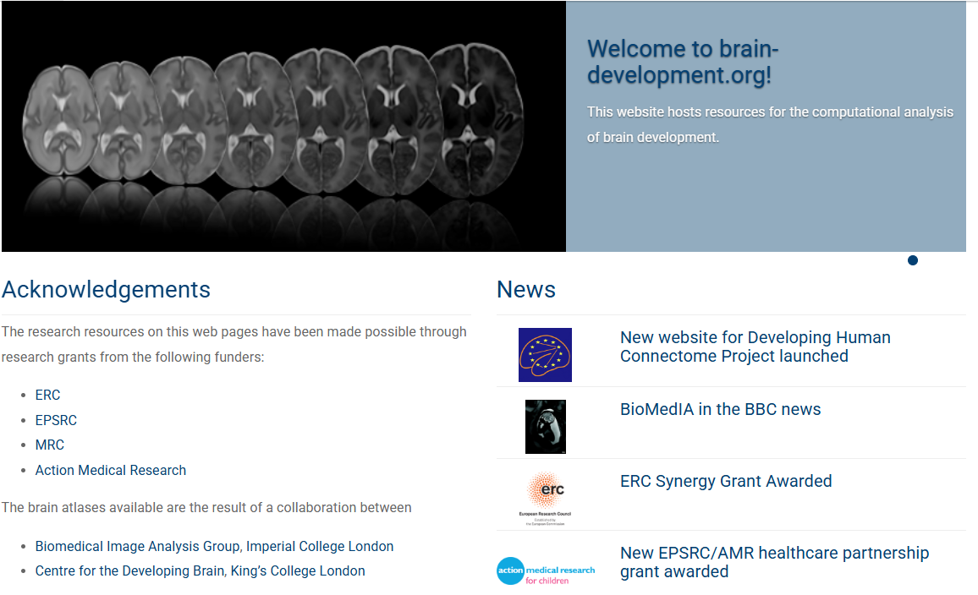
Dataset
577 pair of T1-T2 images
Reshaped the images into 128*128
T1-weighted scans:
Fat appears bright (hyperintense) while water/fluid appears dark (hypointense) and Particularly useful for visualizing normal anatomy and identifying fatty tissues
T2-weighted scans:
Fluid appears bright (hyperintense) while fat appears relatively darker
Particularly sensitive to pathology, inflammation, and edema (swelling)
Fluid appears bright (hyperintense) while fat appears relatively darker

Slide 3
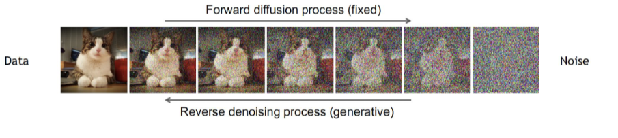
Diffusion
Forward diffusion to gradually add noise to input
Reverse denoising that learns to generate data by denoising

Slide 4
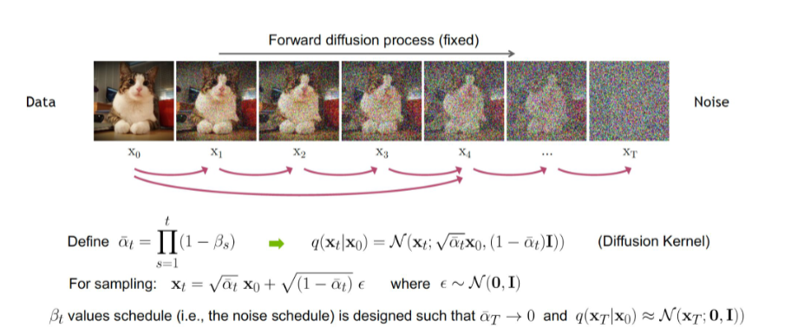
Forward step

Slide 5
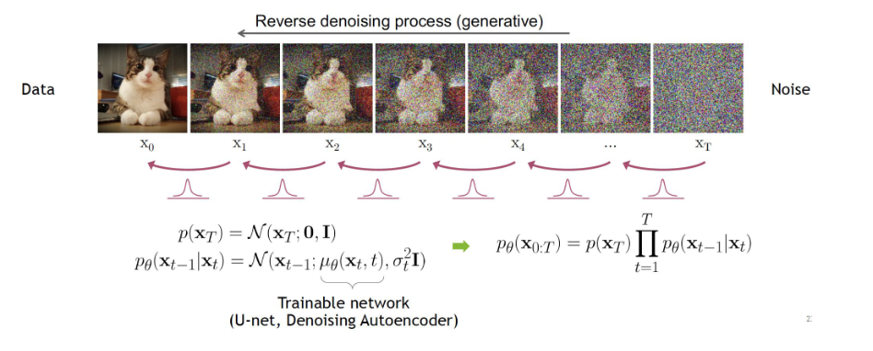
Reverse denoising

Slide 6
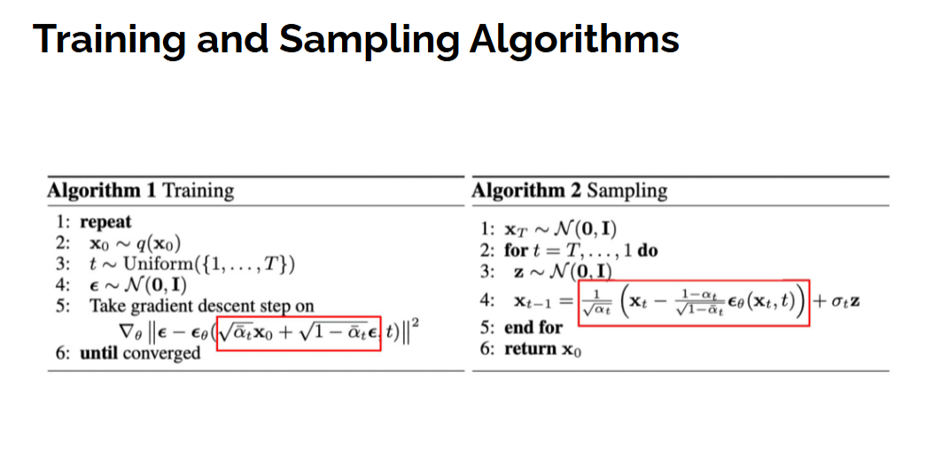
Training
Forward Diffusion Process:
During training, we start with a clean image (x_0)
We add random noise to it according to the timestep t This creates a noisy image (x_t)
Model Prediction:
The model is given the noisy image (x_t) and the timestep (t)
The model's job is to predict what noise was added to create x_t
The output of the model is its prediction of the noise
Loss Calculation:
We compare the model's predicted noise to the actual noise we added
The loss is calculated as the Mean Squared Error (M SE) between the predicted and actual noise
Training Loop:
We perform backpropagation and optimizer steps to minimize this loss
This trains the model to become better at predicting what noise was added

Slide 7
Sampling
Start with random noise (completely random image)
Loop backward through each timestep (from most noisy to least)
For each step:
Ask the model "What noise is in this image right now?"
Remove some of that predicted noise
Add a tiny bit of new random noise (except at the final step)
Image becomes slightly clearer
Repeat until you reach timestep 0
Result: A fully generated image that matches your conditional input

Slide 8
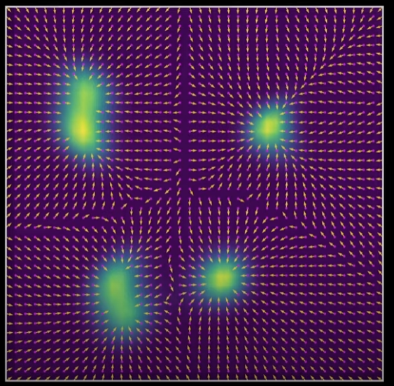
Guidance

Slide 9
Condition
The "condition" parameter refers to the image that guides or conditions the generation process:
Purpose: Tells the model "what" to generate based on
Implementation: Typically concatenated directly with the input image in the channel dimension
Processing: Processed through the same convolutional layers as the input image
Usage in the code: When generating T2 from T1, the T1 image is used as the condition
In the UNet architecture, this likely means the condition image is concatenated with the noisy image at the input layer, creating a multi-channel input that contains both the image being denoised and the conditioning information.

Slide 10
Context
The "context" parameter is used specifically for cross-attention mechanisms:
Purpose: Provides additional information that the model can selectively focus on
Implementation: Used in cross-attention layers, not directly concatenated with the input
Processing: Processed separately from the main input path, then used to guide attention
Usage in the code: Also set to the T1 image when generating T2 (and vice versa)
Cross-attention allows the model to selectively attend to different parts of the context image based on what's relevant for the current denoising step. This is similar to how attention works in transformer models, where the model learns which parts of the context are most important for a given task.

Slide 11
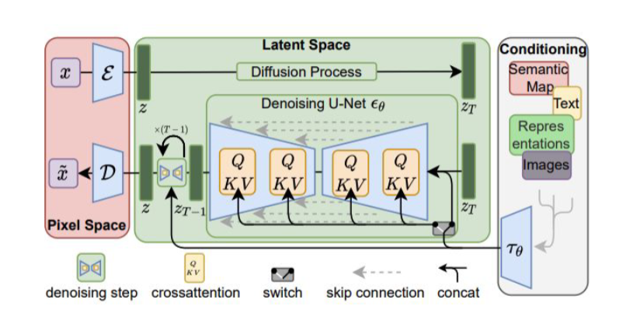
Latent space conditional Diffusion

Slide 12
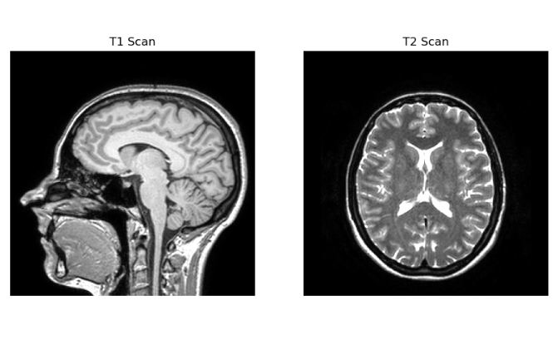
Bidirectional
Purpose of Bidirectional Training
In the context of this MRI translation model, bidirectional training refers to training the model to:
Generate T2 images from T1 images (T1→T2)
Generate T1 images from T2 images (T2→T1)
Benefits of Bidirectional Training
Improved Learning Efficiency:
The model learns shared features between both modalities
Knowledge gained from one direction helps improve the other direction
This often leads to faster convergence and better performance
Balanced Model Performance:
Training in both directions ensures the model performs well on both tasks
This prevents bias toward one modality over the other

Slide 13
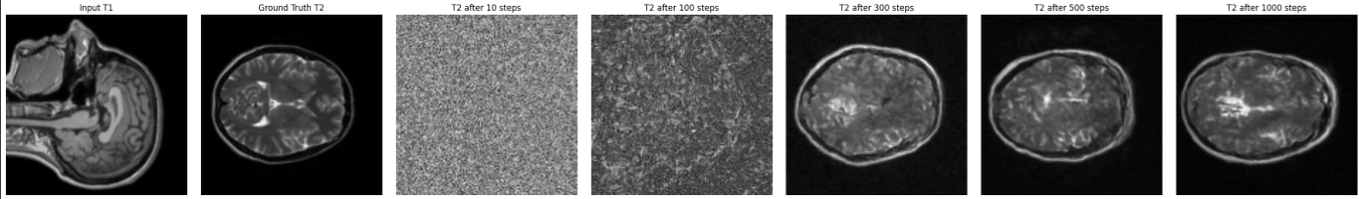
Reverse denoising

Slide 14
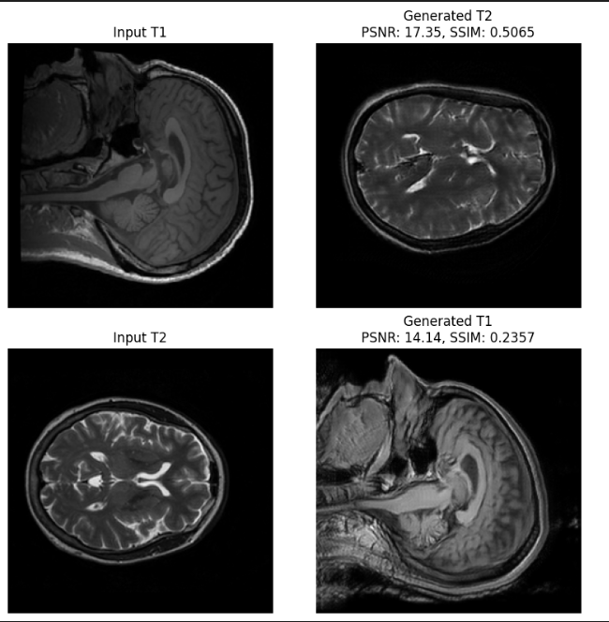
Output:

Slide 15


